Slide 1

Pizza Sales Analysis (using SQL)
- Rohan Patil

Slide 2
Objective
The objective of this project is to analyze pizza sales data to evaluate restaurant performance and identify key sales trends. By assessing total sales, customer preferences, and peak sales periods, we aim to provide actionable insights that will support data-driven decision-making, optimize operational strategies, and plan effectively for future growth.

Slide 3
Agenda
BASIC
Retrieve the total number of orders placed.
Calculate the total revenue generated from pizza sales.
Identify the highest-priced pizza.
Identify the most common pizza size ordered.
List the top 5 most ordered pizza types along with their quantities.
INTERMEDIATE
Join the necessary tables to find the total quantity of each pizza category ordered.
Determine the distribution of orders by hour of the day.
Join relevant tables to find the category-wise distribution of pizzas.
Group the orders by date and calculate the average number of pizzas ordered per day.
Determine the top 3 most ordered pizza types based on revenue.
ADVANCED
Calculate the percentage contribution of each pizza type to total revenue.
Analyze the cumulative revenue generated over time.
Determine the top 3 most ordered pizza types based on revenue for each pizza category.

Slide 4
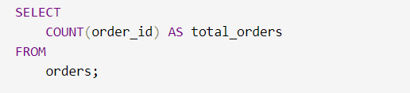
Retrieve the total number of orders placed.
Query
Output
 | total_orders
 | 21350

Slide 5
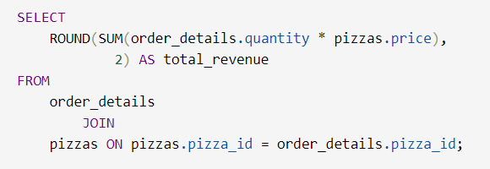
Calculate the total revenue generated from pizza sales.
Query
Output
 | total_revenue
 | 817860.05

Slide 6
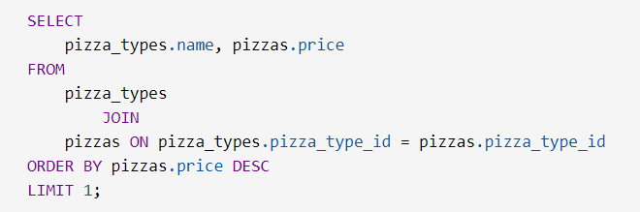
Identify the highest-priced pizza.
Query
Output
 | name | price
 | The Greek Pizza | 35.95

Slide 7
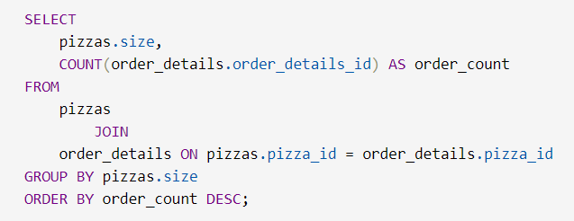
Identify the most common pizza size ordered.
Query
Output
 | size | order_count
 | L | 18526
 | M | 15385
 | S | 14137
 | XL | 544
 | XXL | 28

Slide 8
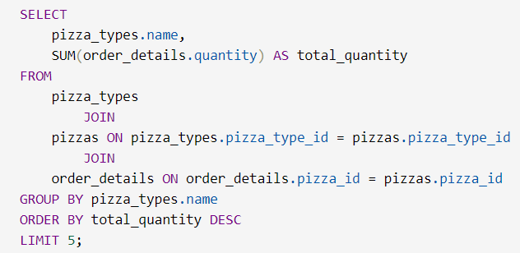
List the top 5 most ordered pizza types along with their quantities.
Query
 | name | total_quantity
 | The Classic Deluxe Pizza | 2453
 | The Barbecue Chicken Pizza | 2432
 | The Hawaiian Pizza | 2422
 | The Pepperoni Pizza | 2418
 | The Thai Chicken Pizza | 2371
Output

Slide 9
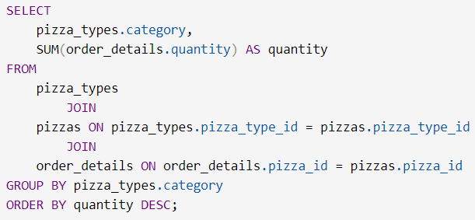
Join the necessary tables to find the total quantity of each pizza category ordered.
Query
Output
 | size | quantity
 | Classic | 14888
 | Supreme | 11987
 | Veggie | 11649
 | Chicken | 11050

Slide 10
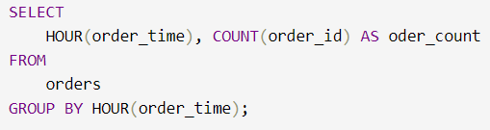
Determine the distribution of orders by hour of the day.
 | HOUR(order_time) | Order_count
 | 11 | 1231
 | 12 | 2520
 | 13 | 2455
 | 14 | 1472
 | 15 | 1468
 | 16 | 1920
 | 17 | 2336
 | 18 | 2399
 | 19 | 2009
 | 20 | 1642
 | 21 | 1198
 | 22 | 663
 | 23 | 28
 | 10 | 8
 | 9 | 1
Query
Output

Slide 11
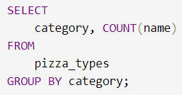
Join relevant tables to find the category-wise distribution of pizzas.
Query
Output
 | category | Count(name)
 | Chicken | 6
 | Classic | 8
 | Supreme | 9
 | Veggie | 9

Slide 12
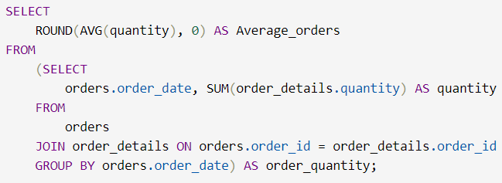
Group the orders by date and calculate the average number of pizzas ordered per day.
Query
Output
 | Average_orders
 | 138

Slide 13
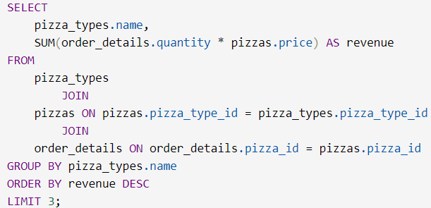
Determine the top 3 most ordered pizza types based on revenue.
Query
 | Name | Revenue
 | The Thai Chicken Pizza | 43434.25
 | The Barbecue Chicken Pizza | 42768
 | The California Chicken Pizza | 41409.5
Output

Slide 14
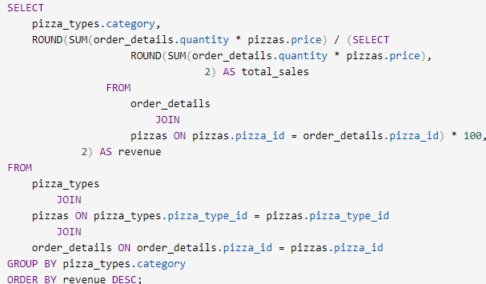
Calculate the percentage contribution of each pizza type to total revenue.
Query
Output
 | Category | Revenue
 | Classic | 26.91
 | Supreme | 25.46
 | Veggie | 23.96
 | Chicken | 23.68

Slide 15
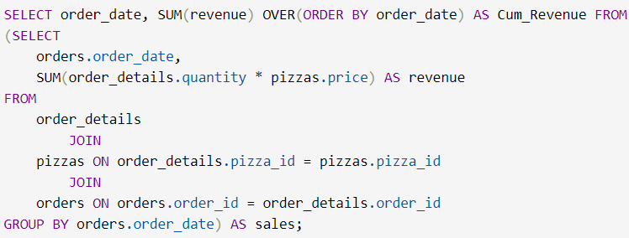
Analyze the cumulative revenue generated over time.
Query
Output
 | order_date | Cum_Revenue
 | 2015-01-01 | 2713.85
 | 2015-01-02 | 5445.75
 | 2015-01-03 | 8108.15
 | 2015-01-04 | 9863.6
 | 2015-01-05 | 11929.55
 | 2015-01-06 | 14358.5
 | 2015-01-07 | 16560.7
 | 2015-01-08 | 19399.05
 | 2015-01-09 | 21526.4
 | 2015-01-10 | 23990.35
 | and so on

Slide 16
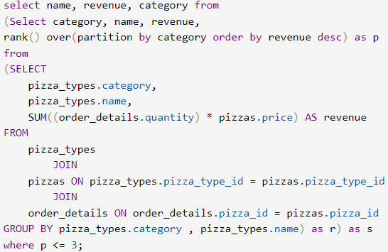
Determine the top 3 most ordered pizza types based on revenue for each pizza category.
Query
Output
 | name | revenue | category
 | The Thai Chicken Pizza | 43434.25 | Chicken
 | The Barbecue Chicken Pizza | 42768 | Chicken
 | The California Chicken Pizza | 41409.5 | Chicken
 | The Classic Deluxe Pizza | 38180.5 | Classic
 | The Hawaiian Pizza | 32273.25 | Classic
 | The Pepperoni Pizza | 30161.75 | Classic
 | The Spicy Italian Pizza | 34831.25 | Supreme
 | The Italian Supreme Pizza | 33476.75 | Supreme
 | The Sicilian Pizza | 30940.5 | Supreme
 | The Four Cheese Pizza | 32265.70 | Veggie
 | The Mexicana Pizza | 26780.75 | Veggie
 | The Five Cheese Pizza | 26066.5 | Veggie

Slide 17
Insights
Large pizzas are the most frequently ordered size, with a total of 18,526 orders.
The Thai Chicken Pizza stands out as a top revenue generator.
The average pizza sale amounts to 138.
The Veggie category reaches a peak of 9.
The total revenue from pizza sales is $817,860.05.
The Classic Deluxe Pizza is the most popular, with 2,453 orders.
Classic pizzas lead in revenue contribution, accounting for 26.91% of total sales.

Slide 18
Through the analysis of pizza sales data, we have gained valuable insights into customer preferences and behaviors, which are crucial for thriving in a competitive market. Our findings reveal which menu categories drive higher sales, the impact of pricing strategies on revenue, and key customer choices that influence purchasing patterns. By understanding these elements, we can refine our offerings to better meet customer demands, enhance pricing strategies, and improve overall operational efficiency. The data-driven insights from this project will enable us to make informed decisions that not only enhance the customer experience but also support sustainable growth and strategic planning for the future.
Conclusion

Slide 19
Thanks!
I hope you found the analysis helpful. Your feedback is important to me and helps improve future presentations. Feel free to share any comments or questions you have. I appreciate your input and look forward to hearing from you!
rohanppp1232@gmail.com
https://www.linkedin.com/in/rohanp14/

